Slide 1

Data Analyst Bootcamp
WEEK 2 PRESENTATION

Slide 2


Initial Concept & Finding Data
Subject of interest
Requirements: Unclean data, 10 variables, 100 records min.
Dataset: Football Transfers 2021 (Kaggle)

Slide 3

Data Cleaning Process
Filtered ‘Team_dest’ (Team Destination) column multiple times to remove each of following:
Omitted 8,900 x ‘Without club’ records found. Reason: No Transfer Fee.
Omitted 653 x ‘Unknown’ records found. Reason: Uncertain & inaccurate.
Omitted 133 x ‘Retired’ records found. Reason: No Transfer Fee.
Omitted 47 x ‘Career break’ records found. Reason: No Transfer Fee.

Slide 4

Data Cleaning Continued…(2)
Filtered ‘Transfer Fee’ column multiple times to remove each of following:
Omitted 7,311 x ‘-‘ records found. Reason: Uncertain & inaccurate.
Omitted 7,120 x ‘?’ records found. Reason: Uncertain & inaccurate.
Omitted 3 x ‘blank’ records found. Reason: Missing data.
Filtered data by ‘Transfer Fee’ column to identify and remove all non-monetary transfers:
Omitted 30,896 x ‘free transfer’ records found. Reason: No Transfer Fee.
Omitted 8,470 x ‘loan transfer’ records found. Reason: No Transfer Fee.
Omitted 23 x ‘draft’ records found. Reason: No Transfer Fee.
Omitted 5 x ‘0’ records found. Reason: No Transfer Fee.

Slide 5

Data Cleaning Continued…(3)
Created new ‘Transfer Fee 2’ column to remove unwanted text “â‚¬” from start of each players’ transfer fee cell. Used formula ‘=MID(J2,FIND("¬",J2)+1,7)’ to extract only the numbers and text after the unwanted text from each cell.
Created/inserted new ‘Loan’ column to identify and separate/remove loan fees from transfer fees using formula =IF(FIND("L",J2),"Loan",K2). Filtered this column by ‘Loan’ and deleted all applicable rows.
Omitted 264 x ‘Loan fees’ records. Reason: Not a permanent transfer fee.
Assumptions made about data: In original ‘Transfer Fee’ column, I am presuming that the ‘m’ stands for millions and the ‘th’ stands for thousands.

Slide 6

Data Cleaning Continued…(4)
Created 2 x new columns to split ‘Transfer Fee 2’ records between millions with ‘Transfer Fee (m)’, and thousands with ‘Transfer Fee (Th.)’. I made the following formulas:
Millions: =MID(K2,FIND("m",K2)-(LEN(K2)-1),(LEN(K2)-1))
Thousands: =MID(K2,FIND("T",K2)-(LEN(K2)-3),(LEN(K2)-3))
Filtered both new columns to remove all formula in ‘#VALUE!’ cells so they will show up as ‘Blank’ when filtered
Created new column ‘Transfer Fee Main’ to incorporate both transfer fee columns together with same unit of measurement to enable comparison.
Multiplied all ‘Th.’ Cells by 1,000 and all ‘m’ cells by 1,000,000 with the formula: =IF(L2="",M2*1000,L2*1000000)

Slide 7

What is the Question?
Analyse 2021 global transfer fees paid in order to identify and compare each of the following, for both highest average transfer fee paid per player and highest total sum of transfers:
Top 5 countries/leagues
Top 5 clubs per league
Most expensive position
Most expensive age range

Slide 8
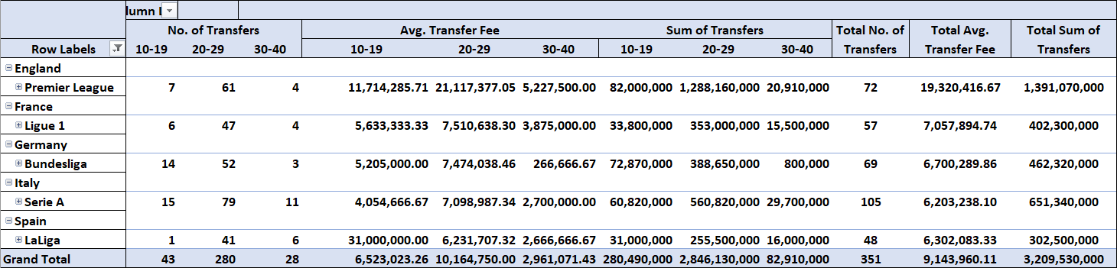
Top 5 Countries/Leagues:

Slide 9
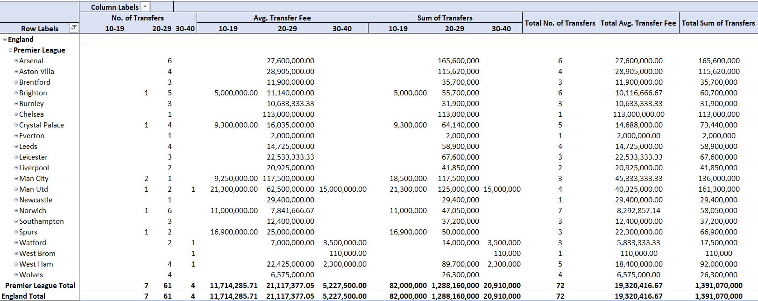
Top 5’s Premier League: Avg. Transfer Fee: Chelsea, Man City, Man Utd, Newcastle, Aston Villa. Sum of Transfer Fee’s: Arsenal, Man Utd, Man City, Aston Villa, Chelsea.

Slide 10
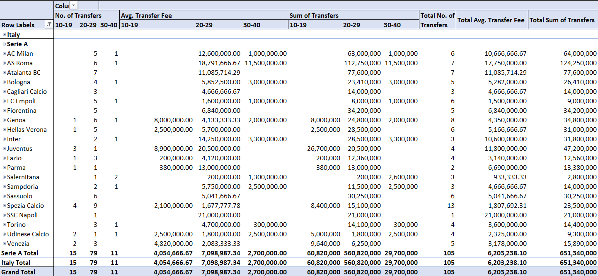
Top 5’s Serie A: Avg. Transfer Fee: Napoli, AS Roma, Juventus, Atalanta, AC Milan. Sum of Transfer Fee’s: AS Roma, Atalanta, AC Milan, Juventus, Genoa.

Slide 11
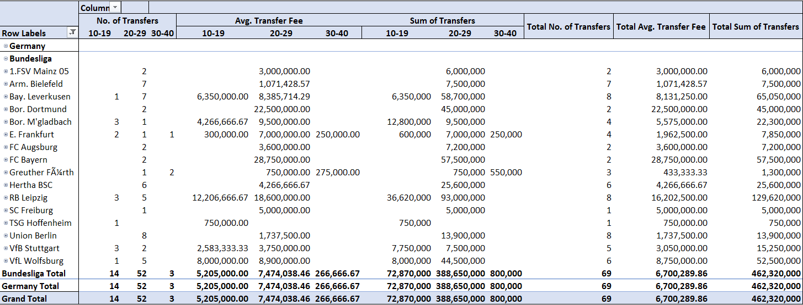
Top 5’s Bundesliga: Avg. Transfer Fee: FC Bayern, Bor. Dortmund, RB Leipzig, Vfl Wolfsburg, Bay. Leverkusen. Sum of Transfer Fee’s: RB Leipzig, Bay. Leverkusen, FC Bayern, Vfl Wolfsburg, Bor. Dortmund.

Slide 12
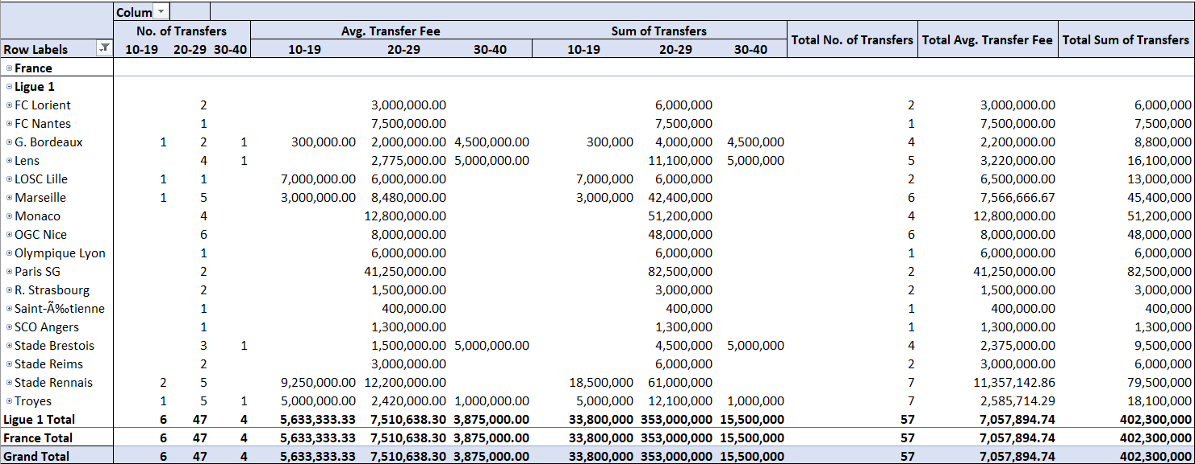
Top 5’s Ligue 1: Avg. Transfer Fee: Paris SG, Monaco, Stade Rennais, OGC Nice, Marseille. Sum of Transfer Fee’s: Paris SG, Stade Rennais, Monaco, OGC Nice, Marseille.

Slide 13
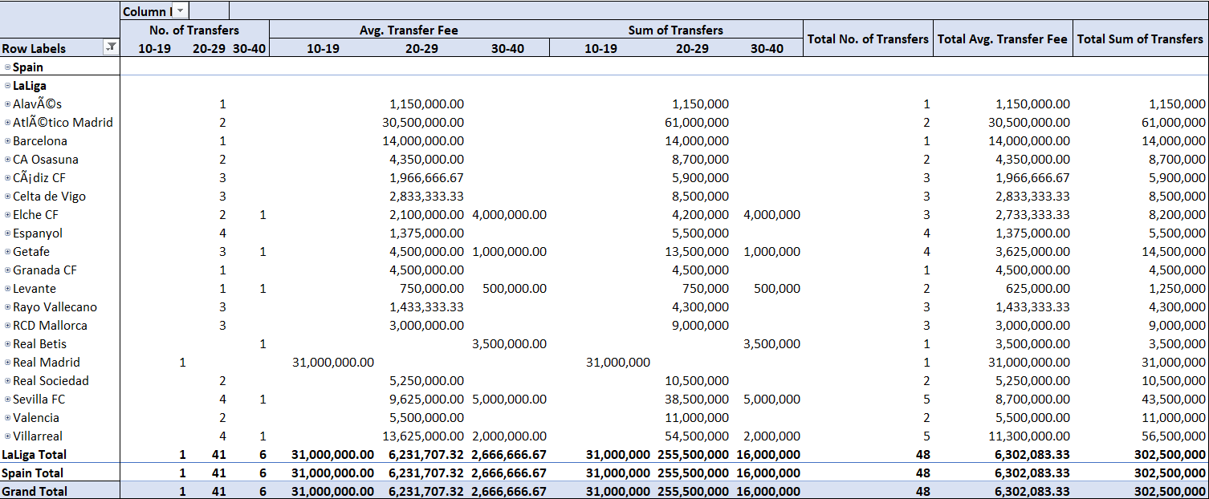
Top 5’s La Liga: Avg. Transfer Fee: Real Madrid, Atletico Madrid, Barcelona, Villarreal, Sevilla FC. Sum of Transfer Fee’s: Atletico Madrid, Villarreal, Sevilla, Real Madrid, Getafe.

Slide 14
Limitations
My laptop unable to delete large amounts of Excel worksheet data in one go without crashing, so it took me a long time to delete the unwanted data in batches of around 250-500 rows at a time.

